Slide 1

Name: AnkushProject Title: Handwritten Digit Recognition using CNNCourse / Department: (Add yours)Overview:
Passionate about AI/ML and deep learning
This project explores how neural networks can read handwritten digits
Uses Convolutional Neural Networks for image-based classification

Slide 2

Introduction
Handwritten digit recognition aims to identify numbers from images of human handwriting.
Widely used in postal automation, bank cheque processing, and OCR systems.
Deep learning, especially CNNs, has greatly improved accuracy in image recognition tasks.
Objective
Build and train a CNN model for classifying handwritten digits (0–9).
Use the MNIST dataset to achieve high accuracy with minimal errors.
Evaluate model performance using accuracy metrics and predictions.

Slide 3

Tech Stack Used
Programming & Frameworks
Python
TensorFlow / Keras
Tools
Jupyter Notebook
NumPy & Pandas
Matplotlib for visualization
Dataset
MNIST handwritten digits dataset

Slide 4
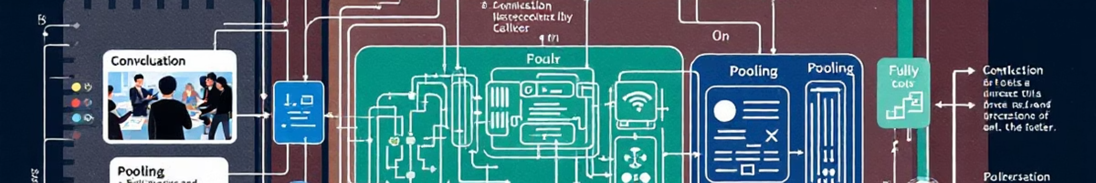
What is a Convolutional Neural Network (CNN)?
CNNs are specialized neural networks engineered for image data, leveraging convolutional layers to automatically extract hierarchical local features like edges and shapes.
Convolutional Layers
Pooling Layers
Fully Connected Layers
Apply learnable filters to detect specific patterns and features within localized regions of the input image.
Reduce the spatial dimensions of the feature maps, thereby reducing computational complexity and memory usage while retaining essential information.
Interpret the high-level features extracted by earlier layers and classify them into predefined digit classes (0-9).
CNNs offer several benefits, including fewer parameters compared to fully connected networks, translation invariance (ability to recognize patterns regardless of their position), and efficient feature learning.

Slide 5

The MNIST Dataset: Benchmark for Digit Recognition
The MNIST (Modified National Institute of Standards and Technology) dataset is the de facto standard benchmark for evaluating digit recognition models. It comprises:
70,000 grayscale images of handwritten digits (0-9).
Each image is standardized to a 28x28 pixel resolution.
Split into 60,000 images for training and 10,000 for testing.
This dataset is crucial because it allows for consistent comparison of model performance with minimal preprocessing, making it ideal for academic and technical projects.

Slide 6

Advantages & Limitations
Advantages
High Accuracy: CNNs achieve excellent results for handwritten digit classification.
Automatic Feature Extraction: No need for manual feature engineering—CNN learns patterns automatically.
Robust to Variations: Works well even when digits vary in size, style, or thickness.
Scalable: Model can be extended to recognize alphabets or complex handwriting.
Limitations
Requires Large Data: Performance depends heavily on the amount and quality of training data.
Computationally Expensive: Training deep CNNs can be slow without GPU support.
Limited to MNIST: Real-world handwriting is much more diverse than the MNIST dataset.
Overfitting Risk: Without proper regularization, model may memorize instead of learning patterns.

Slide 7
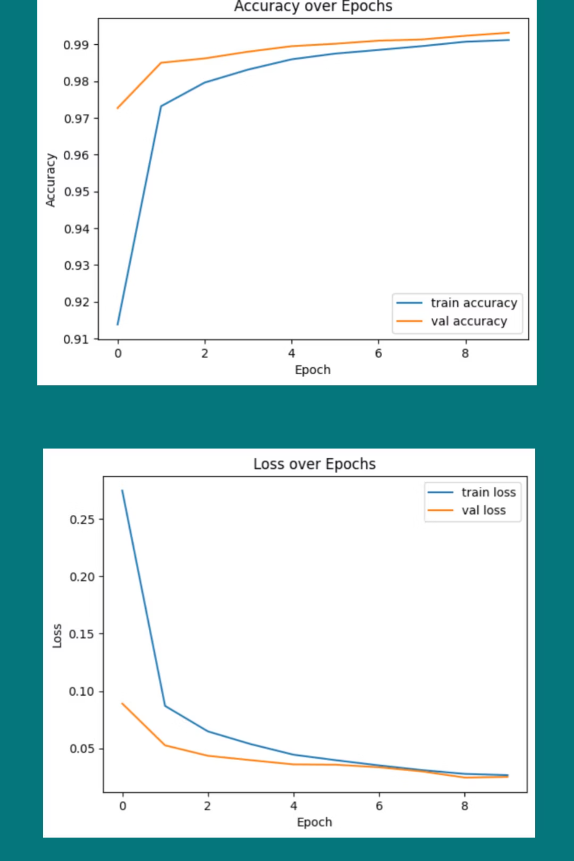
Training & Evaluation
Training Setup
Optimizer: Adam
Loss Function: Categorical Crossentropy
Epochs: (Add your value)
Metrics: Accuracy
Evaluation
Achieved accuracy: (Add your result, e.g., 98%)
Low loss indicates good convergence
Model performs well on unseen test data
Visuals to add
Training accuracy curve
Training loss curve

Slide 8

Results & Predictions
Results
Model accurately identifies digits 0–9
High test accuracy achieved
Robust performance across sample images
Visual Predictions
Sample images with predicted labels
Highlight both correct and misclassified examples
Confusion matrix (optional but recommended)
Conclusion
CNN successfully recognizes handwritten digits with high accuracy
Demonstrates the power of deep learning in image classification tasks

